Slide 1
Nanostructured Materials lecture-5
Characterization and characterization techniques of nanomaterials
Dr. Suha I. Al- Nassar

Slide 2
NANOMATERIALS CHARACTERIZATION ISSUES
For what
Optimisation for production and quality assurance
– Characteristics for specific applications
– Interaction with biological systems
– Behaviour in the environmenty.
Chemical Characterization Techniques:
To study the internal chemical structural details, chemical characterization is done by Optical Spectroscopy such as :
(a) Optical Absorption Spectroscopy (OAS)
(b) Photoluminescence (PL)
(c) Fourier Transform Infrared Spectroscopy (FTIR) and Raman Spectroscopy

Slide 3
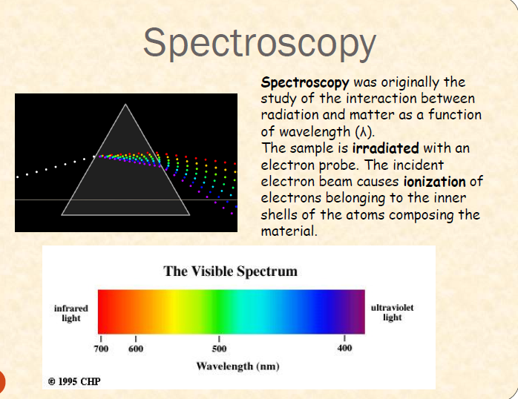

Slide 4
Optical Spectroscopy:
Optical spectroscopy uses the interaction of light with matter as a function of wavelength or energy in order to obtain information about the material. Absorption or emission experiments with visible and UV light tend to reveal the electronic structure. Vibrational properties of the lattice (i.e., phonons) are usually in the IR and are studied either using IR absorption or Raman spectroscopy. Optical spectroscopy is attractive for materials characterization because it is fast, nondestructive and of high resolution.

Slide 5
(a) Optical Absorption Spectroscopy
Ultraviolet-VIsible Spectroscopy ( UV-visible spectroscopy)
ultraviolet-visible spectrophotometer (UV- Vis) involves the spectroscopy of photons in the UV-Visible region. It uses light in the visible and adjacent near ultraviolet (UV) and near infrared (NIR) ranges. In this region of the electromagnetic spectrum, molecules undergo electronic transitions. UV-Vis Spectrophotometers are mainly used to measure transmission or absorption in liquids and transparent or opaque solids. It does so by sending a beam of light through the sample and then monitoring the remaining light in a detector. In the case of a UV-Vis spectrophotometer the light is in the wavelength of 800 - 200nm, probing electronic transitions in the sample.
When sample molecules are exposed to light having an energy that matches a possible electronic transition within the molecule, some of the light energy will be absorbed as the electron is promoted to a higher energy orbital. A spectrophotometer records the wavelengths at which absorption occurs, together with the degree of absorption at each wavelength.

Slide 6
(b ) Photoiuminescence Spectroscopy:
Photoluminescence (PL) is a process in which a substance absorbs photons (electromagnetic radiation) and then re-radiates photons. Quantum mechanically, this can be described as an excitation to a higher energy state and then a return to a lower energy state accompanied by the emission of a photon.
If a light particle (photon) has an energy greater than the band gap energy, then it can be absorbed and thereby raise an electron from the valence band up to the conduction band across the forbidden energy gap. In this process of photoexcitation, the electron generally has excess energy which it loses before coming to rest at the lowest energy in the conduction band. At this point the electron energy eventually falls back down to the valence band. As this happens, the energy it loses is converted back into a luminescent photon which is emitted from the material. Thus the energy of the emitted photon is a direct measure of the band gap energy, Eg. The process of photon excitation followed by photon emission is called photoluminescence

Slide 7
(c) FTIR and Raman spectroscopy
FTIR and Raman Spectroscopy as Non-Destructive Inspection Methods for Aerospace and other Industries. A wide range of non-destructive testing methods such as IR thermography or fluorescent penetration rely on the detection of light to measure a physical change in the material under inspection. FTIR (Fourier Transform Infrared) spectroscopy extends the use of light in the mid-infrared wavelength region to monitor chemical changes on the surface of a material that can affect the strength and/or performance of that material. Raman spectroscopy is an analogous analysis method that provides information on the chemical composition of a material on the surface of a structure. Both methods offer chemical information that is often not available by traditional NDT methods.
FTIR uses light in the mid-infrared wavelength region to obtain chemical information from a surface. Light in the mid-IR wavelength region illuminates a surface, and the FTIR system monitors light that is reflected off the surface. The chemical composition of the surface modifies the reflectance characteristics of the light at different wavelengths. An FTIR system can be used to provide a chemical signature of the material on the surface.

Slide 8
Raman spectroscopy is related to FTIR spectroscopy. In a Raman measurement, a surface is illuminated with a laser. The Raman spectrometer monitors light that is scattered off the surface. As with FTIR, the specific wavelengths of scattered light are related to the chemical composition of the surface. Each technique offers advantages for specific applications, and the measurement can be tailored to be optimized to obtain the optimal results.
FTIR and Raman spectroscopic methods provide information on the chemical composition of a material. In situations where an unknown material is found after operation of a device, these techniques can be used to identify the material and often, the cause of the failure can be identified. As an example, FTIR and Raman spectroscopy can be used for measuring the thickness of coatings on a surface. The chemical signatures measured by FTIR and Raman spectroscopy often permit the coating thickness to be measured in the presence of other coatings that are made up of different materials. Typical examples of this work include the thickness of primer coatings and the thickness of anodization coatings on metallic substrates.
Also ,Composite materials may consist of a number of different resin systems. FTIR and Raman spectroscopy can be used to classify these different resins for recycling and disposal purposes.

Slide 9
5.2.2 Structural Characterization
Variation in the size of nanoparticle determines the optical properties of the material. Simillarly, for different applications of the nanomaterial, the information about the shape, lattice constants and crystallinity are important. To know the size, shape, lattice constants and crystallinity of the material, structural characterization is done. The techniques are
5.2.2.1 X-ray diffraction technique
5.2.2.2 Electron microscopy:
a) Scanning Electron Microscopy (SEM)
b) Transmission Electron Microscopy(TEM)
c) Atomic Force Microscopy (AFM)

Slide 10
X-ray diffraction technique
X-ray diffraction (XRD) is a non-destructive type of analytical technique which provides valuable insight about the lattice structure of a crystalline substance like unit cell dimensions, bond angles, chemical composition and crystallographic structure of natural and manufactured materials .XRD is based on the principle of constructive interference of x-rays and the sample concerned which should be crystalline. The x-rays which are generated by a CRT are filtered, collimated and then directed towards the sample. The interaction that follows produces constructive interference based on Bragg’s law which relates wavelength of the incident radiations to the diffraction angle and lattice spacing.

Slide 11
X-Ray Diffraction
How it works?
  An electron in an alternating electromagnetic field will oscillate with the same frequency as the field. When an X-ray beam hits an atom, the electrons around the atom start to oscillate with the same frequency as the incoming beam. In almost all directions we will have destructive interference, that is, the combining waves are out of phase and there is no resultant energy leaving the solid sample. However the atoms in a crystal are arranged in a regular pattern, and in a very few directions we will have constructive interference. The waves will be in phase and there will be well defined X-ray beams leaving the sample at various directions. Hence, a diffracted beam may be described as a beam composed of a large number of scattered rays mutually reinforcing one another.
Crystal systems, space groups, reciprocal lattice, Miller indices…
Planes going through areas with high electron density will reflect strongly, planes with low electron density will give weak intensities.

Slide 12
Sample preparation
Single crystal X-ray diffraction
  The single crystal sample is a perfect crystal (all unit cells aligned in a perfect extended pattern) with a cross section of about 0.3 mm.
  The single crystal diffractometer and associated computer package is used mainly to elucidate the molecular structure of novel compounds.
Powder (polycrystalline) X-ray diffraction
  It is important to have a sample with a smooth plane surface. If possible, we normally grind the sample down to particles of about 0.002 mm to 0.005 mm cross section. The ideal sample is homogeneous and the crystallites are randomly distributed. The sample is pressed into a sample holder so that we have a smooth flat surface.

Slide 13
Data collection and analysis
Collecting data: computer and software
Analysis:
  ICDD database – Identification
  Structure refinement – GSAS
  Quantitative phase analysis – GSAS
  Novel structure – single crystal

Slide 14
X-ray diffraction technique
X-ray diffractometers can be used either for single crystals or for powders.
X-ray powder diffraction (XRD) is rapid analytical technique primarily used for phase identification of the crystalline material and can provide information on unit cell dimension and atomic spacing. The X-ray are generated by cathode ray tube, filtered to produce monochromatic radiation, collimated to concentrate, and directed towards the sample. The interaction of the incident monochromatic rays with the sample produces constructive interference (and diffracted ray) when condition satisfy Bragg’s Law nλ = 2d Sinθ This equation relates the wavelength (λ) of electro-magnetic radiation to the diffraction angle (θ) and the lattice spacing (d) in a crystalline sample by scanning the sample through arrangement of 2θ angles.

Slide 15
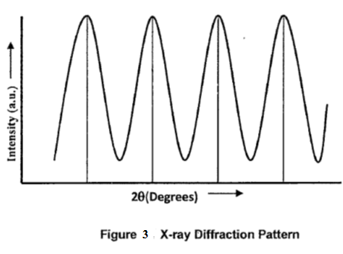
All the possible diffraction directions of the lattice are attained due to the random orientation of the powdered materials Although the method of X-ray diffraction is quantitative, in general ,it is used for qualitative analysis. This form of analysis, extends to all crystalline solids including ceramics, metals, insulators, organic, polymers, thin film powders etc.
While single crystal diffractometers are used for the study of molecular structure, powder diffractometers are used for analysis of phases, though the latter can also be used to derive molecular information.
The angle and intensities of the diffracted X-rays are used to perform crystallographic studies. The intensity of the diffracted X-rays is measured as a function of the diffraction angle 2 θ (Figure 3).The intensities of the spots provide information about the atomic basis. The sharpness and shape of the spots are related to the perfection of the crystal , The structure of the material can be obtained from intensity Vs 2θ plot

Slide 17
Electron microscopy: a) Scanning Electron Microscope (SEM)
A scanning electron microscope (SEM) is a type of electron microscope that images a sample by scanning it with a high-energy beam of electrons in a raster scan pattern. The electrons interact with the atoms that make up the sample producing signals that contain information about the sample's surface topography, composition, and other properties such as electrical conductivity. SEM can produce very high-resolution images of a sample surface, revealing details about less Due to the very narrow electron beam, SEM micrographs have a large depth of field yielding a characteristic three-dimensional appearance useful for understanding the surface structure of a sample. Under vacuum, electrons generated by a source are accelerated in a field gradient. The beam passes through Electromagnetic Lenses, focusing onto the specimen. As result of this bombardment different types of electrons are emitted from the specimen. A detector catches the secondary electrons and an image of the sample surface is constructed by comparing the intensity of these secondary electrons to the scanning primary electron beam. Finally the image is displayed on a monitor. In most of the applications, the data collected is over a pre selected area of the sample surface and following this, a 2D image is generated that shows the various spatial variations. Conventional SEMs with a magnification range of 20X-30000X with a spatial resolution of 50-100 nm can scan areas which vary from 1 cm to 5μm in width. SEMs also have the ability to analyze particular points as can be seen during EDX operations which help in determining the chemical composition of the sample concerned.

Slide 18
(b) Transmission Electron Microscope (TEM):
A transmission electron microscope is constituted of: (1) two or three condenser lenses to focus the electron beam on the sample, (2) an objective lens to form the diffraction in the back focal plane and the image of the sample in the image plane, (3) some intermediate lenses to magnify the image or the diffraction pattern on the screen. If the sample is thin (< 200 nm) and constituted of light chemical elements, the image presents a very low contrast when it is focused. To obtain amplitude contrasted image, an objective diaphragm is inserted in the back focal plane to select the transmitted beam (and possibly few diffracted beam): the crystalline parts in Bragg orientation appear dark and the amorphous or not Bragg oriented parts appear bright. This imaging mode is called bright field mode (BF).In diffraction mode, other intermediate lens is inserted to image on the screen the diffraction pattern of the back focal plane. If the diffraction is constituted by many diffracting phases, each of them can be differentiated by selecting one of its diffracted beams with the objective diaphragm. To do that, the incident beam must be tilted so that the diffracted beam is put on the objective lens axis to avoid off- axis aberrations .This mode is called dark field mode DF. The BF and DF modes are used for imaging materials to nanometer scale. SAED and micro diffraction patterns of a crystal permit to obtain the symmetry of its lattice and calculate its interplanar distances (with the Bragg law). This is useful to confirm the identification of a phase, after assumptions generally based on the literature of the studied system and on chemical analyses

Slide 20
c) Atomic Force Microscopy (AFM)
The Atomic Force Microscope is a kind of scanning probe microscope in which a topographical image of the sample surface can be achieved based on the interactions between a tip and a sample surface. The atomic force microscope was invented by Gerd Binning et al. in 1986 at IBM Zurich based on the STM (Scanning Tunneling Microscope) already presented in 1981. While the latter depends on the conductive samples, the AFM allows also the use of non- conductive samples.
A typical AFM consists of a cantilever with a small tip (probe) at the free end, a laser, a 4-quadrant photodiode and a scanner.The surface characteristics can be
explored with very accurate resolution in a range of 100 μm to less than 1 μm.
This Fi gure Schematic diagram showing the operation principle of the AFM .

Slide 21
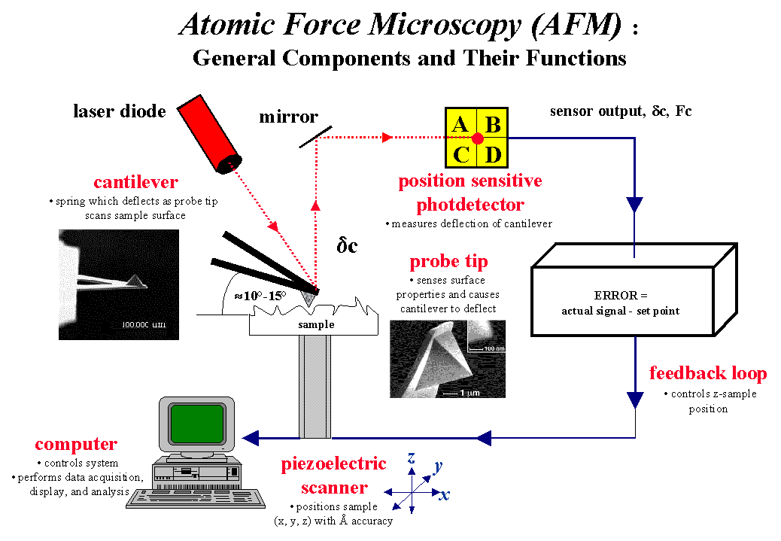

Slide 22
a tip is used for imaging. It is generally made of silicon or silicon nitride (Si3N4). It approaches the sample in a range of interatomic distances (around 10 Å). The tip is commonly 3-15 microns in length. It is attached to the end of the spring cantilever. The cantilever is around 100-500 microns in length. When the tip, which is attached to the free end of the cantilever, come very close to the surface attractive and repulsive forces due to the interactions between the tip and the sample surface cause negative or positive bending of the cantilever. This bending is detected by the help of a laser beam.
the cantilever. The cantilever can be thought of as a spring. The quantity of the generated force between the tip and the surface depends on the spring constant (stiffness) of the cantilever and the distance between the tip and the surface. This force can be characterized with Hooke’s Law.
F=-k·x
If the spring constant of the cantilever is less than surface, a bending occurs in the cantilever and this deflection is monitored. As the tip travels across the sample, it moves up and down according to the surface properties of the sample (eg. topography). These fluctuations are sourced by the interactions (electrostatic, magnetic, capillary, Van der Waals) between the tip and the sample. The displacement of the tip is measured and a topographical image is obtained.

Slide 23
Piezoelectric materials (piezocrystals) are ceramic materials that can enlarge or shrink when a voltage is applied. By this way, very precise movements in the x,y,z directions can be possible.
A laser beam is focused onto the back of the cantilever. It can be reflected back to a 4-quadrant photodiode detector. By the help of this position sensitive photodiode, the bending of the cantilever can be measured precisely.
The cantilever deflects according to the atomic force variations between tip and the sample and thereby the detector measures the deflection. The created image is a topographical illustration of the sample surface

Slide 24
Operation Modes
Contact mode
In contact mode, the tip is in a soft physical contact with the surface. The tip is able to move above the surface with a specific height or under a constant force. The movement is strongly influenced by frictional and adhesive forces that can cause damage to the sample. When the spring constant of cantilever is less than surface, the cantilever bends. The force on the tip is repulsive. By maintaining a constant cantilever deflection (using the feedback loops) the force between the probe and the sample remains constant and an image of the surface is obtained.
Dynamic (Tapping) Mode
This mode eliminates the frictional force by intermittently contacting the surface and oscillating with sufficient amplitude to prevent it from being trapped in by adhesive forces. This mode of operation is less destructive than contact mode. The cantilever oscillates nearby its resonance frequency. An electronic feedback loop provides the oscillation amplitude remaining constant so that a constant tip-sample interaction is conserved during the scan.
Non contact mode
In this mode tip does not touch the sample, however it oscillates above the surface during scan. It uses feedback loop to monitor changes in the amplitude due to attractive Van der waals forces so the surface topography can be monitored. It is better soft samples.

Slide 25
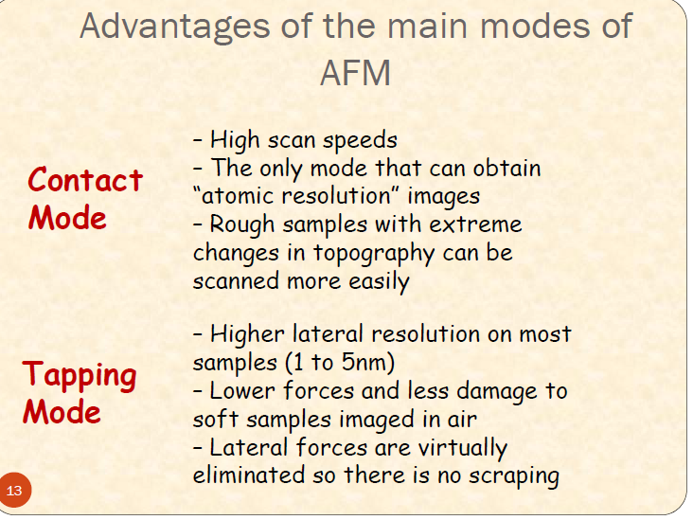

Slide 26
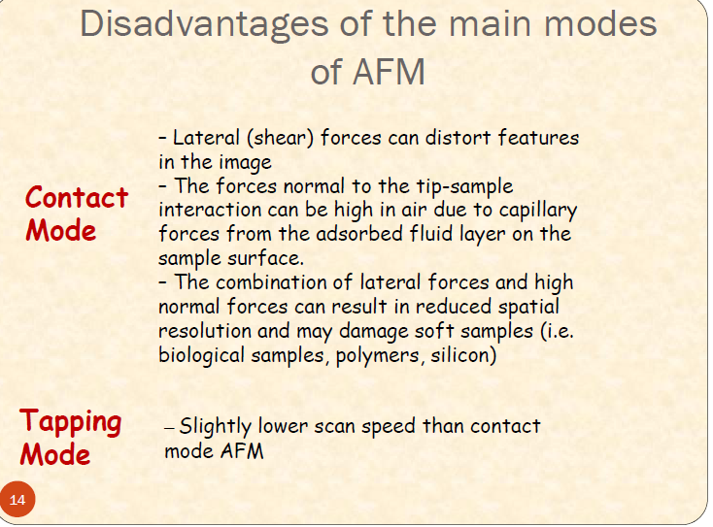

Slide 27
